Slide 1
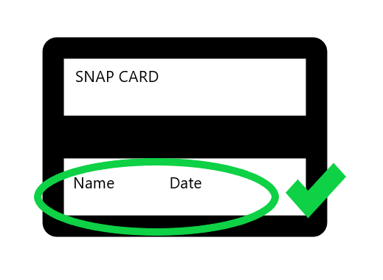
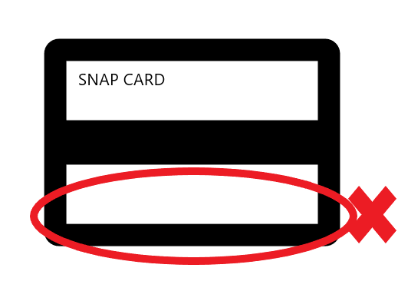
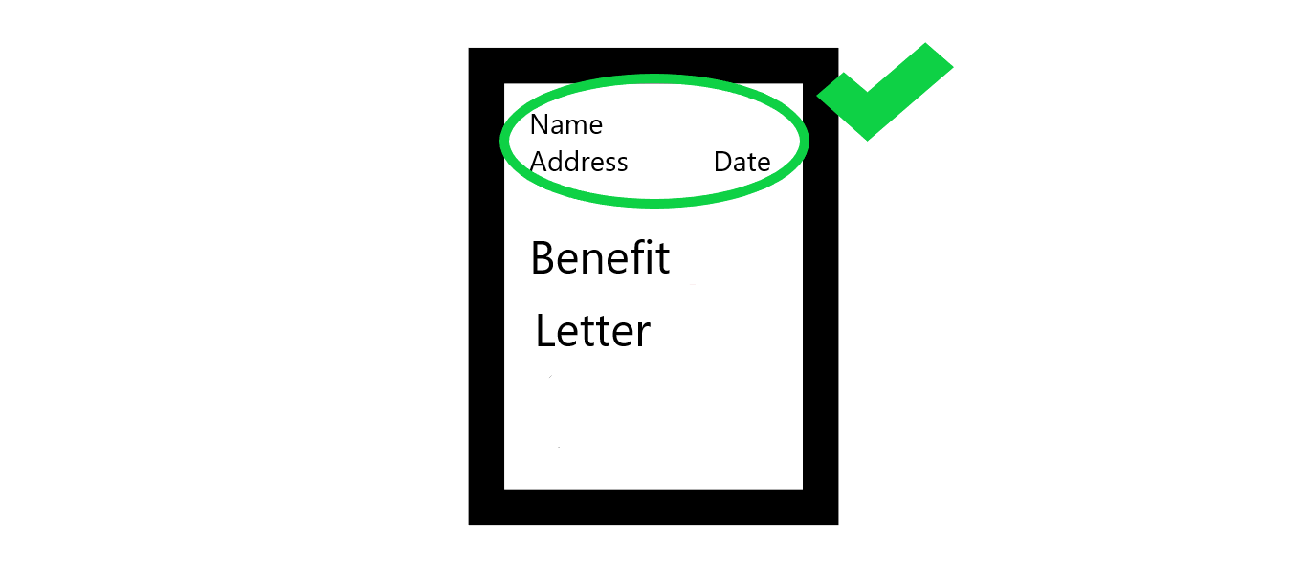
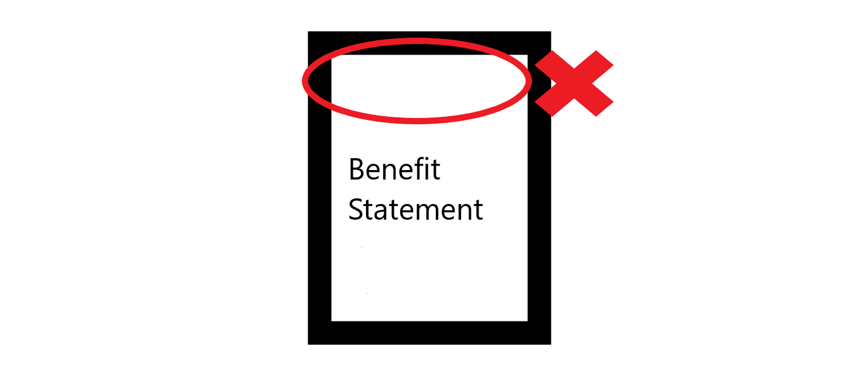
ONE of the following Eligibility Documents is required
if customer is applying for Assurance Wireless with SNAP or Medicaid
Benefit ID Card with Name and either an Issue Date or Expiration Date printed on card (for example, SNAP or MEDICAID card).
The Issue date must be within the last 12 months or the expiration date must be in the future. Cards with expiration dates in the past or issue dates more than a year old will not be accepted.
Acceptable | Not Acceptable
OR
Award or Notice Letter of Participation from an authorized government agency. MUST include Applicant’s Name & Address and be dated within the past 12 months
OR
Benefit Statement for Qualifying Program MUST include Applicant’s Name & Address and be dated within the past 12 months
10/11/19

